Slide 1
COM6103 Team Software Project
2nd Sprint Meeting with Clients
NiceFace Project brief
presentation by team16
Client：Dr Li Sun
Advisor：Nada AbdelRahman
April 23, 2020

Slide 2
Completed Work
Testing the new model: YOLOv3 and Tiny-YOLO.
Modified the code.
Run the code on GPU.
Running model on ROS.
Algorithm
Interface
Implement the design of Web.
Using ROS Bridge WebSocket to interact with ROS node.
Learn how to use docker.
Instructs other members to load the docker image.
Prepare to create an image.
Docker
Organize meeting minutes.
Edit document outline.
Documentation

Slide 3
Subsequent Work
Evaluate and measure models.
Create an image.
Complete document.
Interface.

Slide 4
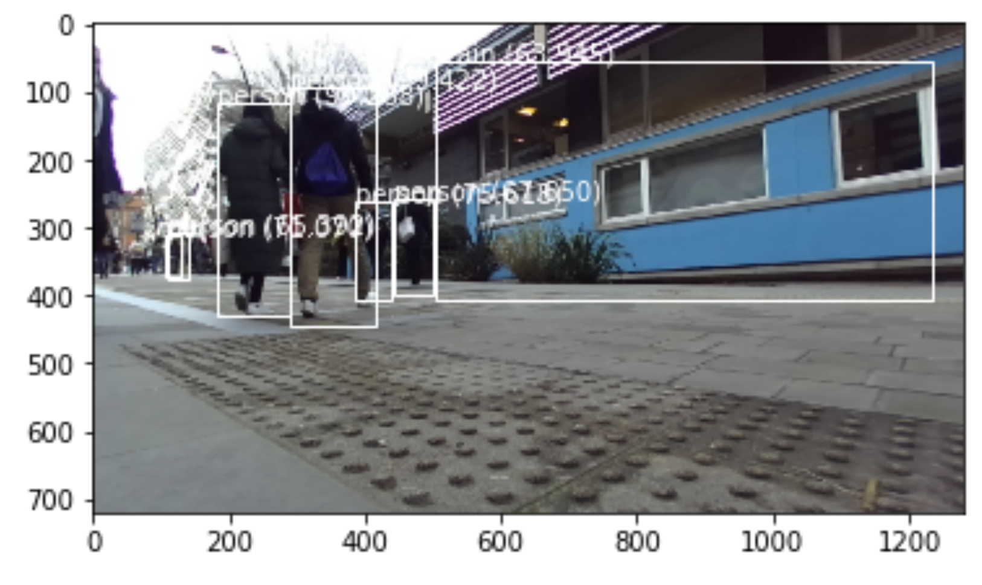
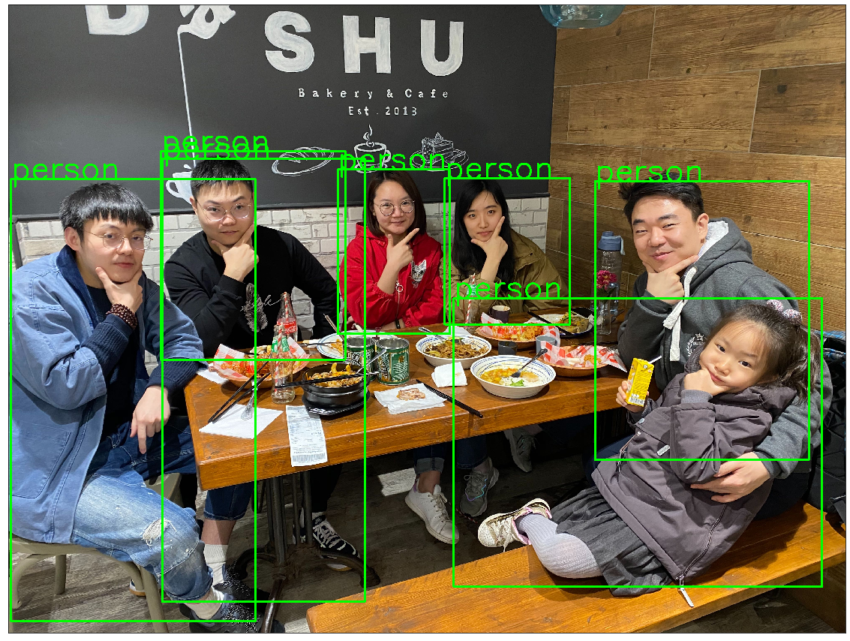
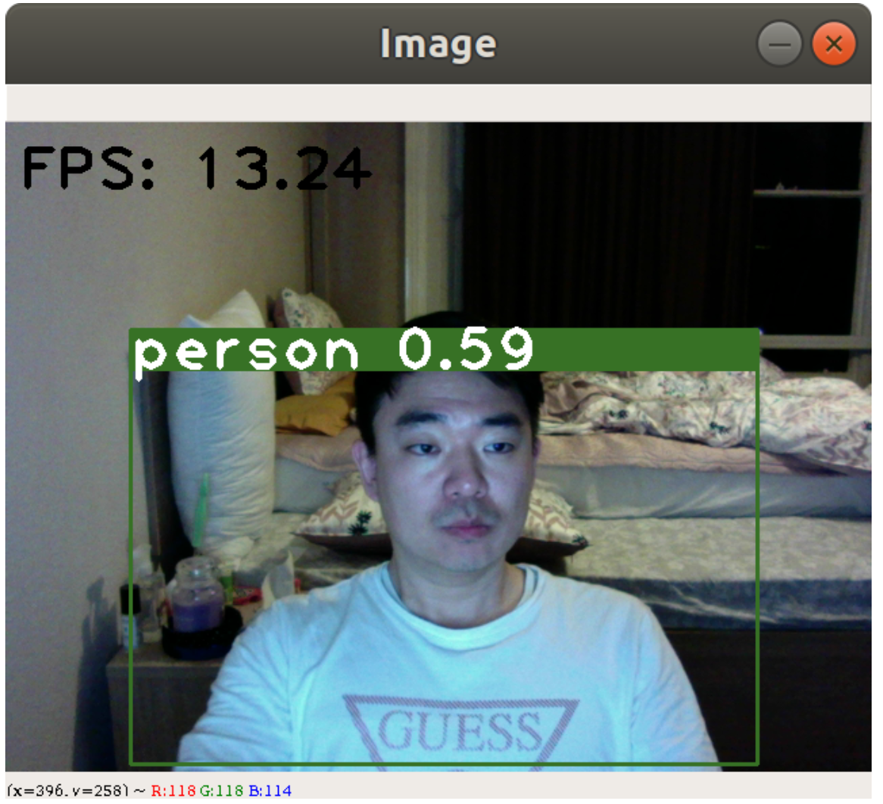
Demo Result
YOLOv3
Fast R-CNN
YOLO-Tiny

Slide 5
Questions and confusion
1. How to evaluate a model? What indicators are needed?
2. Which method is better, using RQt or WebSocket?

Slide 6
THANK YOU

